Slide 1
UNT Campus Carry Policy

Slide 2
Disclaimer
This PowerPoint is intended to provide individuals with the basic information from UNT’s Campus Carry Policy and is for License To Carry Holders (LTC).
If you choose to carry a concealed handgun on UNT property, as a license holder, you are responsible for knowing Texas statutory requirements.

Slide 3
Campus Carry
Signed into law by Governor Abbott June, 2015.
The University may not establish rules that generally prohibit license holders from carrying concealed handguns.
Went into effect August 1st, 2016.
More information on “Constitutional Carry” can be found on slide 35.

Slide 4
Policy Statement
UNT is committed to providing a safe environment for students, faculty, staff, and visitors, and to respecting the right of individuals who are permitted by law to carry a firearm.
UNT Campus Carry policy can be viewed online at campuscarry.unt.edu

Slide 5
Applicability
All faculty, staff, students, guests, visitors, & individuals & organizations doing business on behalf of the University on the campus property.
License Holders issued a License to Carry (LTC) a handgun by the Texas Department of Public Safety under Chapter 411 of Texas Government Code.
Does not apply to commissioned peace officers.

Slide 6
Procedures & Responsibilities
A LTC holder may not carry a handgun openly on the campus of an institution of higher education such as UNT.
A LTC holder may not carry a concealed handgun while intoxicated.
A LTC holder is not required to self-identify as such unless directed by a law enforcement officer.

Slide 7
Procedures & Responsibilities
Employee w/ a LTC may carry into his or her work space, unless location is prohibited by law or policy.
Not authorized to use weapon in course or scope of duties.
Carrying is a personal decision & not on behalf of the University.
Employee accepts personal liability for any injury or damage as result of use of handgun not the University.

Slide 8
Concealed Handgun
A LTC holder may carry a concealed handgun while on campus premises.
Except for areas with the 30.06 signage (or similar).
“Concealed Handgun” means a handgun, the presence of which is not openly noticeable to the ordinary observation of a reasonable person.
Different weapon law requirements apply to off campus locations.

Slide 9
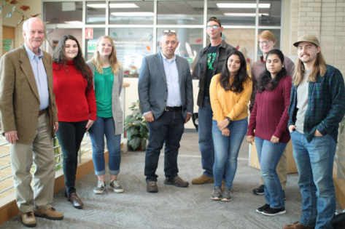
Concealed Handgun
This is what you should see.

Slide 10
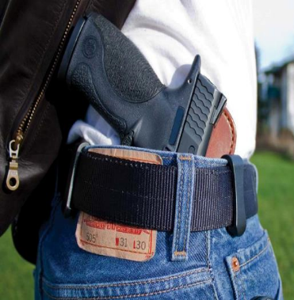
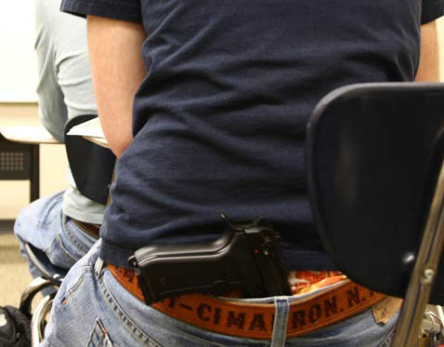
Concealed Handgun
This is NOT what you should see.

Slide 11
If you see a handgun on campus
LTC Holders must intentionally or knowingly display the handgun in plain view to be a criminal offense.
Do not confront the individual(s)!
Be a good witness
Avoid escalating the situation
Contact the UNT Police Department immediately!
911 or 940-565-3000

Slide 12
Reporting to the Police
When you report a crime or suspicious person we need to know:
Specific location(s).
Type of incident.
Description of person(s)/suspect(s)/vehicle:
Think TOP DOWN: race/gender/clothing/other unique attributes (carrying a blue backpack, long ponytail, noticeable limp, etc.).
If no longer visible, last known location/direction headed.
If safe to do so, take a photo with your cell phone.
Remember, WE CAN’T HELP IF WE DON’T KNOW

Slide 13
Locations Where Concealed Handguns are Prohibited

Slide 14
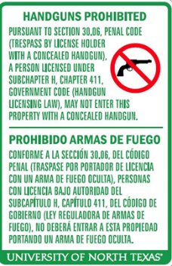
Effective Notice
In writing in both English & Spanish.
Must be placed in a manner that is clearly visible to the public.

Slide 15
Concealed Handguns Prohibited
At a location used as a church, synagogue, or other establish religious worship.
At a location used as a polling place on the day of a federal, state, or local election.
At a location used by a court.
In a nonpublic, secure portion of the UNT Police Department.

Slide 16
Concealed Handguns Prohibited
Location where substances designated as “immediately dangerous to life and health” are present, access is restricted to the individuals who perform research or duties, and a sealed & filtered environment is essential.
In a laboratory where biological hazards, defined by policy, are present.
In an area where equipment that is incompatible w/ metallic objects is present, such as magnetic resonance imaging (MRI) & nuclear magnetic resonance (NMR) machines.
Specifically:

Slide 17
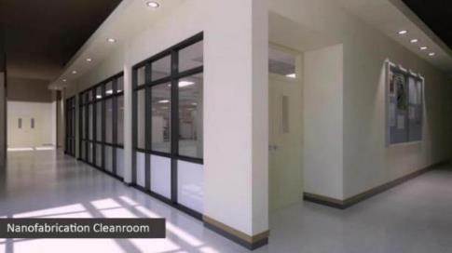
Concealed Handguns Prohibited
Biosafety Level
3 or 4
Clean Room at Discovery Park

Slide 18
Concealed Handguns Prohibited
Where a state or federal law or contract, at the sole discretion of the organization with whom the contract is entered requires exclusion of a handgun in a specific location.
Exclusion can not generally prohibit license holders from carrying concealed handguns on the campus premises

Slide 19
Concealed Handguns Prohibited
At a location where medical, health, or clinical services are provided.
At a location where services to minors are provided.
Specifically:

Slide 20
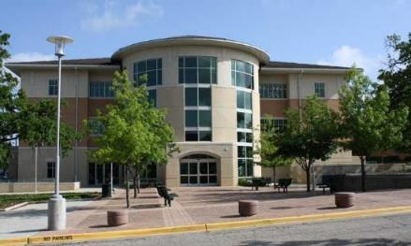
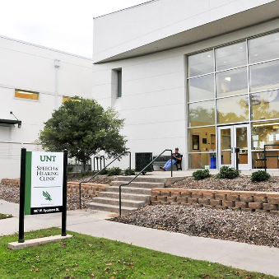
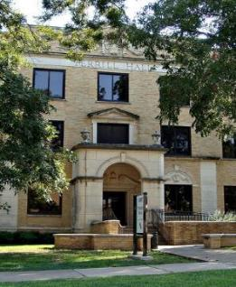
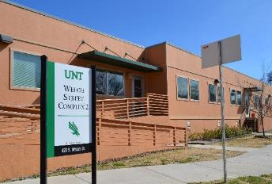
Concealed Handguns Prohibited
Chestnut Hall
Speech & Hearing Clinic
in
Speech & Hearing Building
Psychology Clinic in
Terrill Hall
Welch Street Complex 2

Slide 21
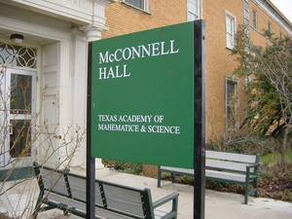
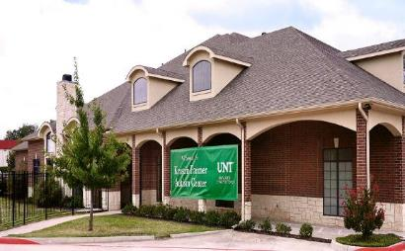
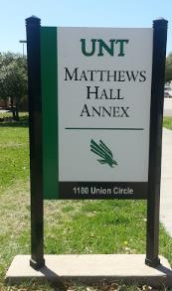
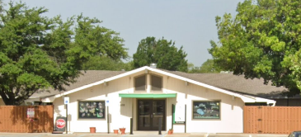
Concealed Handguns Prohibited
McConnell Hall
Kristen Farmer
Autism Center
Child Development Lab
Child & Family Resource Center
in Matthews Annex

Slide 22
Concealed Handguns Prohibited
At a location where special student services are provided.
Specifically:

Slide 23
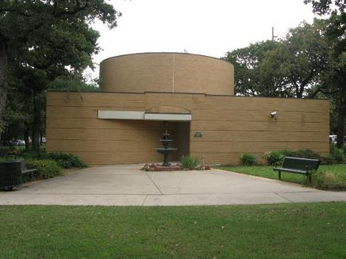
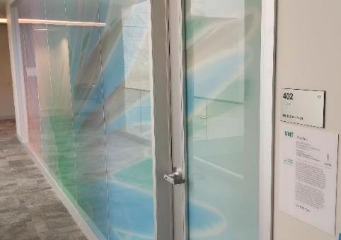
Concealed Handguns Prohibited
Goolsby Chapel
Union Meditation Room

Slide 24
Concealed Handguns Prohibited
At a location where intercollegiate, club, & intramural athletic events occur on campus premises.
Specifically:

Slide 25
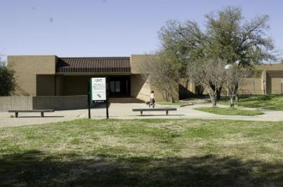
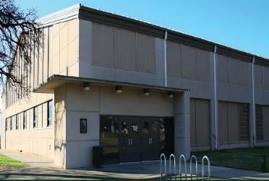
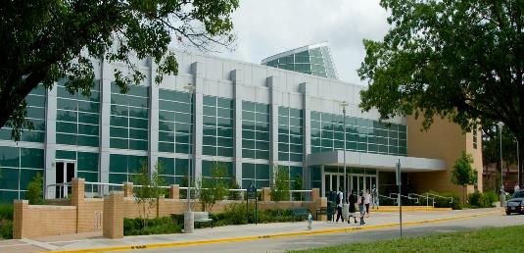
Concealed Handguns Prohibited
Physical Education Building
Ken Bahnsen
Gym
POHL
Recreation Center

Slide 26
Concealed Handguns Prohibited
Location where a large-scale events occur on the campus premises.
Large scale events includes any function or event, other than a classroom or academic program, where attendance is reasonably anticipated to exceed 200 individuals.
Specifically:

Slide 27
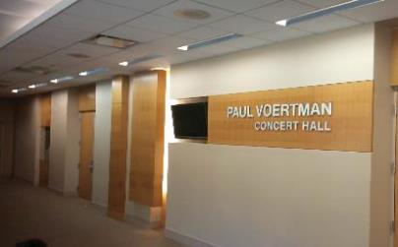
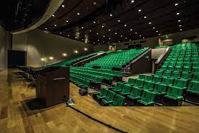
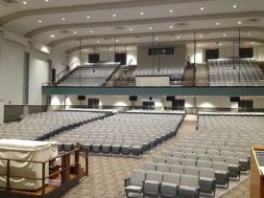
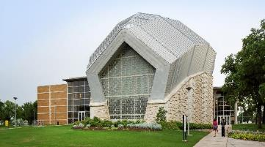
Concealed Handguns Prohibited
Voertman Concert Hall
in Music Building
Union Lyceum
g
Main Auditorium
in Auditorium Bldg
Murchinson
Performing Arts Center

Slide 28
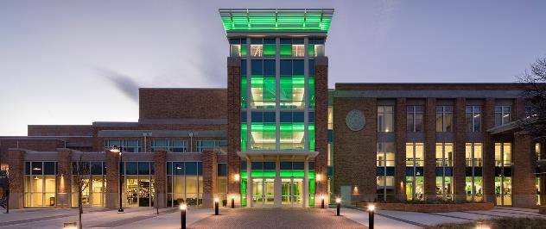
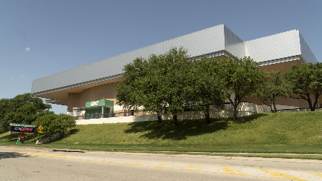
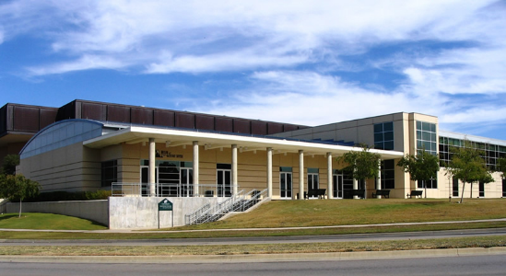
Concealed Handguns Prohibited
Coliseum
Ballrooms in
Gateway & Union

Slide 29
Concealed Handguns Prohibited
At Activities where:
Intercollegiate, club, & intramural athletic events occur on campus.
University and high school graduations occur.
Specifically:

Slide 30
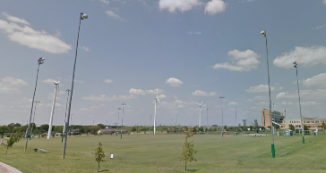
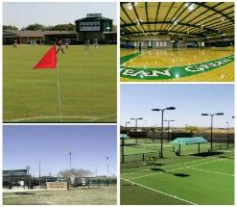
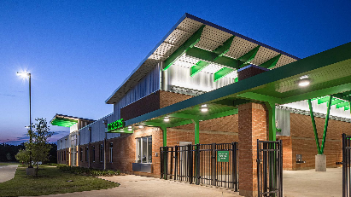
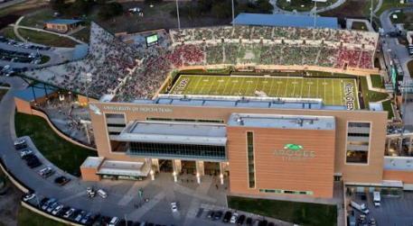
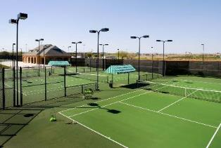
Concealed Handguns Prohibited
Fields used for
Intramural Activities
MGV Sports
Complex
Track and Soccer
Stadium
Warranch Tennis
Complex
Apogee Stadium

Slide 31
Campus Housing Residents
A resident LTC holder may carry a concealed handgun into campus housing & may store the weapon in his or her private residential room.
Except during periods between the spring and fall semesters.
The weapon must be carried on his or her person at all times or stored in a University installed or approved locked container in his or her private residential room.
May not intentionally or knowingly display a handgun in plain view of another person except as necessary to properly store the weapon in his or her private residential room.

Slide 32
Temporarily Prohibiting
The President or designee may prohibit carrying of concealed handguns for up to 7 days to promote safety on campus premises:
When activity has a history for violence; or
Where a large-scale activity,
Due to the presence of alcohol,
Uniqueness of the campus environment,
Specific threat of violence, or
Other safety considerations present a reasonable threat to health or safety.

Slide 33
Temporarily Prohibiting
The University Chief of Police may prohibit the carrying of concealed handguns on campus premises :
When it reasonably appears there is a threat of injury to human life, destruction to University property, or a threat of willful disruption or orderly operation of University (Education Code 51.231)
Upon receipt of credible information of imminent injury to human life or destruction to University property.

Slide 34
Temporarily Prohibiting
Review of decision to temporarily restrict:
A LTC holder may request a review of decision.
Request must be in writing to reviewing official & describe why allowing concealed handguns does not present a safety concern.
Reviewing official must notify LTC holder no later than 2 days after receiving request.
Decision of reviewing official is final.

Slide 35
Constitutional Carry
“Constitutional Carry” means the carrying of a firearm, including a handgun, openly or concealed without a license, except where prohibited by law. “Constitutional Carry” is prohibited within UNT buildings.
Was Effective September 1, 2021
Texas law allows most individuals to carry a handgun in most places in Texas. This change is often referred to as “constitutional carry” to distinguish it from the former “license to carry” terminology.
License to Carry (LTC) holders are still required to conceal their handgun when on UNT campus.

Slide 36
Questions???
If you have any additional questions, call the
UNT Police Department’s Non-Emergency line at:
940-565-3000

